Slide 1
Gnutella Protocol
Juan Armijos

Slide 2
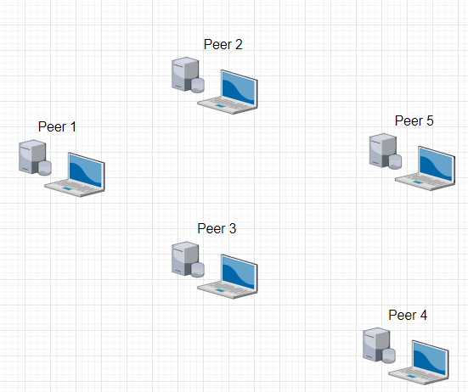
Red: PING Green: PONG

Slide 8
UDP
Peer 4 requests file2.txt
Peer 2 has file2.txt

Slide 9
UDP
Peer 3 requests file5.txt
Peer 5 has file5.txt

Slide 10
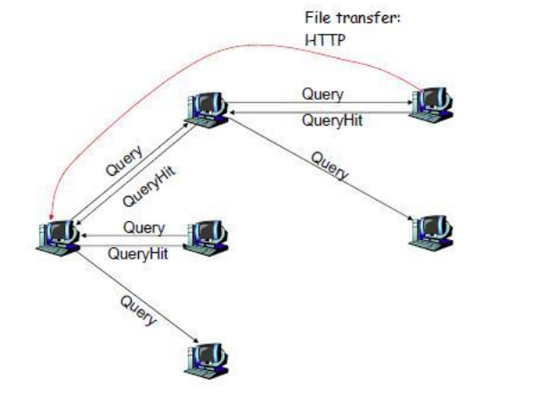
How it looks

